Slide 1
BIOTECHNOLOGY AND ITS APPLICATION

Slide 2
Biotechnology and Its Applications
Therapeutics
Diagnostics
Genetically modified crops for agriculture
Processed food
Bioremediation
Waste treatment
Energy Production

Slide 3
TISSUE CULTURE
Agrobacterium is a bacterium used in genetic engineering of plants. The diagram shows stages in the transfer of a gene into a plant.

Slide 4
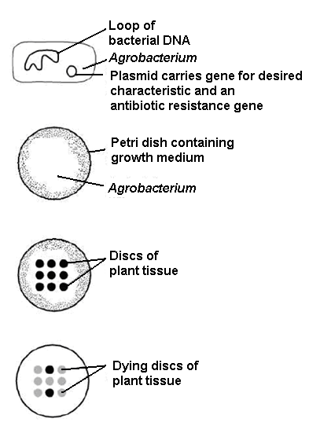
Stage 1
Gene transferred to Agrobacterium
Stage 2
Agrobacterium cultured on growth medium
Stage 3
Discs of plant tissue placed on bacterial culture
Stage 4
Discs transferred to growth medium containing an antibiotic that usually kills plant cells
Stage 5
Any surviving discs transferred to medium that stimulates plant cells to divide by mitosis, forming a callus
Stage 6
Calluses divided into many pieces and transferred to a growth medium that causes a new plant to grow from each piece

Slide 5
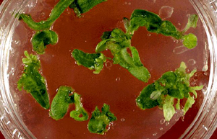
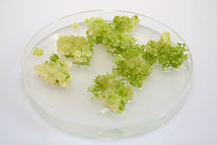
Callus is a mass of undifferentiated cells derived from plant tissue
A mass of callus tissue is formed that is just starting to make new plantlets.

Slide 6
a) In stage 2, explain why the bacteria are cultured before the plant tissue is added. (1)
To give time for bacteria to reproduce and be present in large numbers to infect plant cells.
Stage 2
Agrobacterium cultured on growth medium
Stage 3
Discs of plant tissue placed on bacterial culture

Slide 7
b) In stage 4, explain why the growth medium contains antibiotic. (2)
To kill plant cells which are not transgenic.
Stage 4
Discs transferred to growth medium containing an antibiotic that usually kills plant cells

Slide 8
c) Suggest why stages 5 and 6 are necessary for the commercial production of genetically engineered plants. (2)
Plants must be made on a large scale to be commercially viable. Thus clones are made by tissue culture.
Stage 5
Any surviving discs transferred to medium that stimulates plant cells to divide by mitosis, forming a callus
Stage 6
Calluses divided into many pieces and transferred to a growth medium that causes a new plant to grow from each piece

Slide 9
The following pictures deal with TISSUE CULTURE – technique to clone plants.

Slide 10
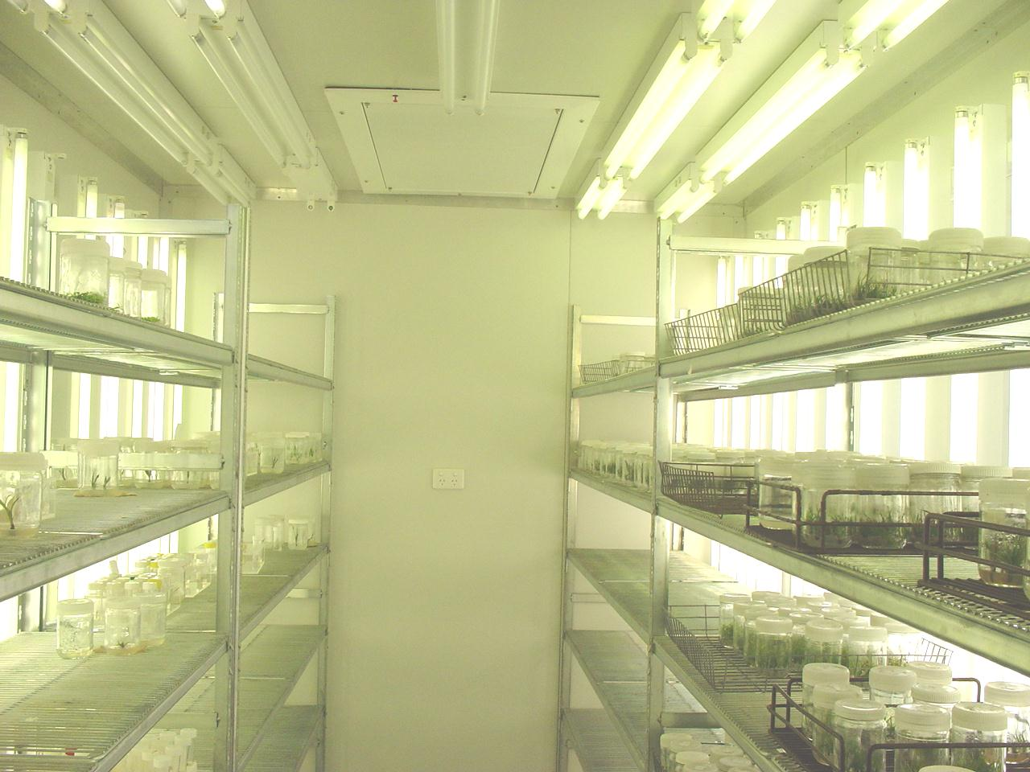

Slide 11
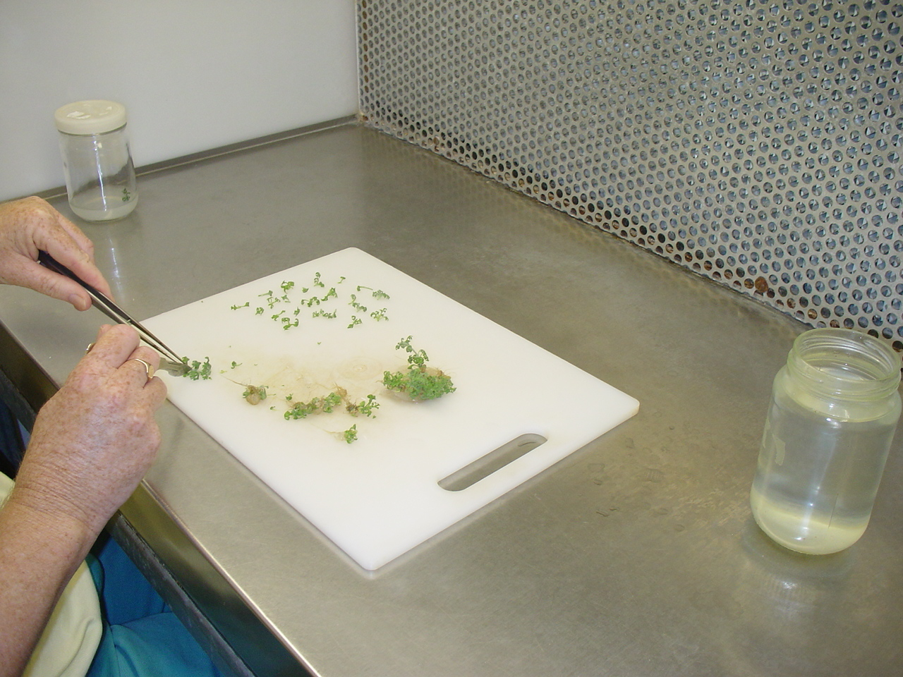

Slide 12
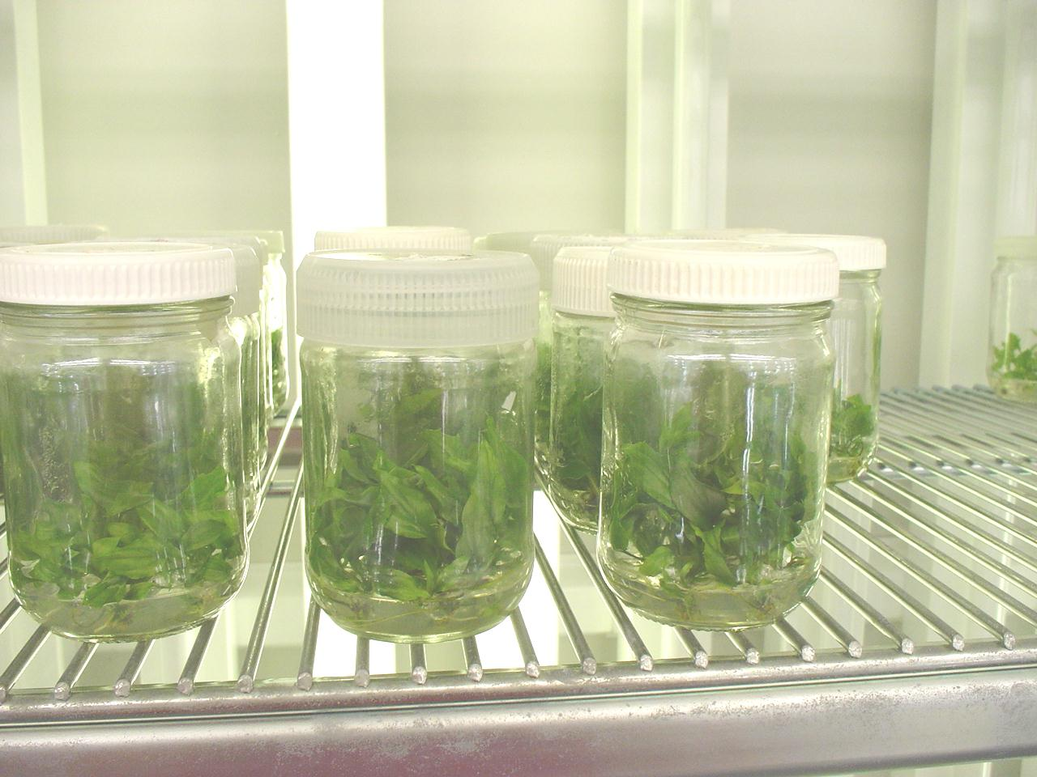

Slide 13
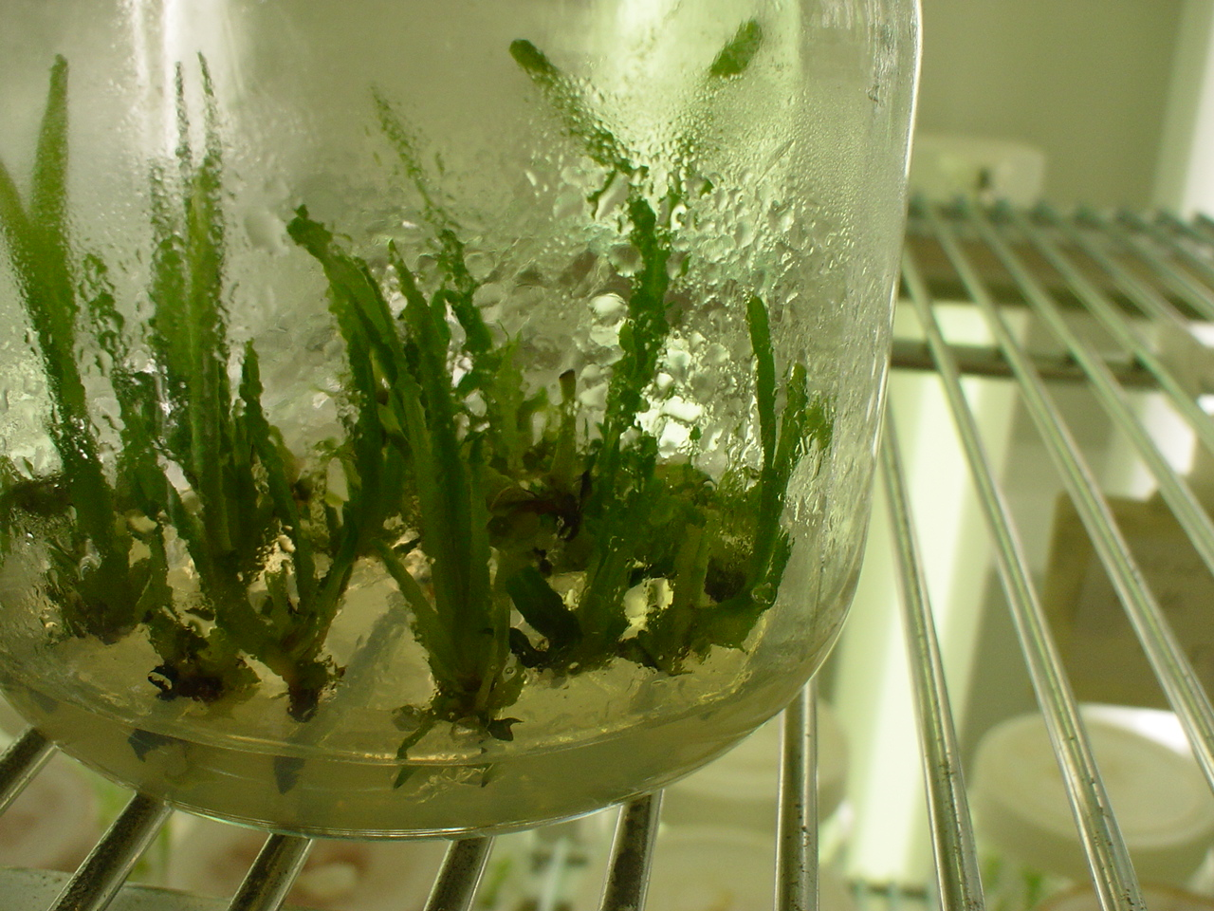

Slide 14
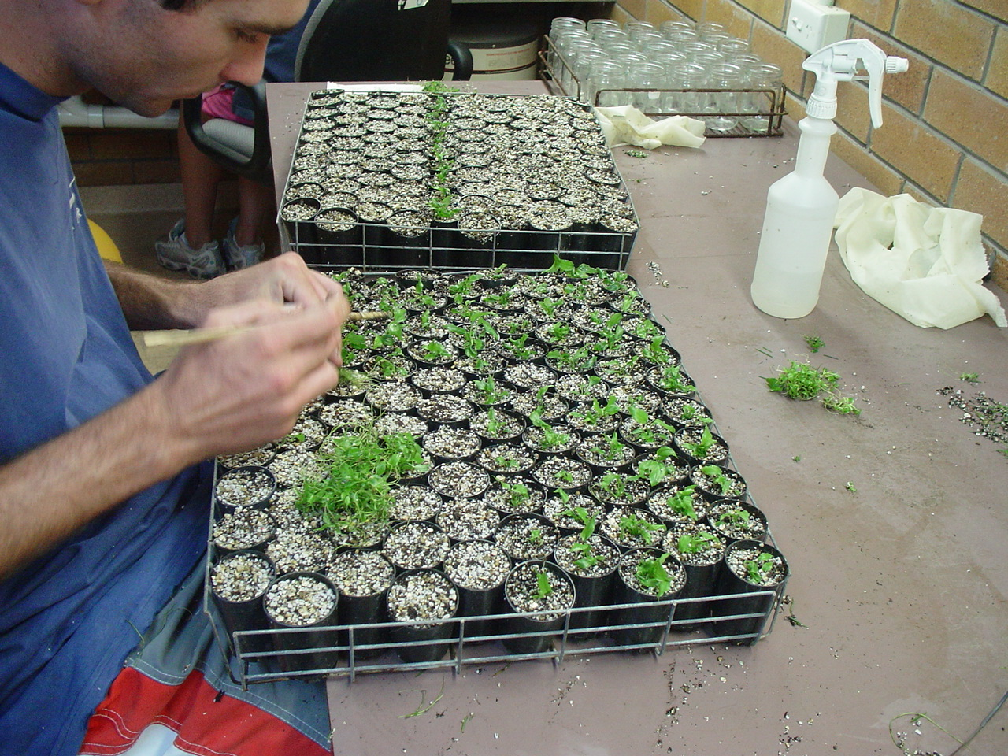

Slide 15
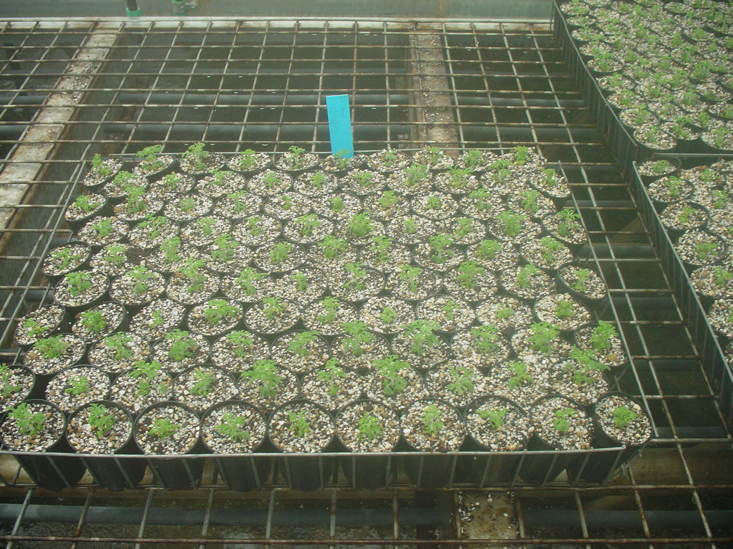

Slide 16
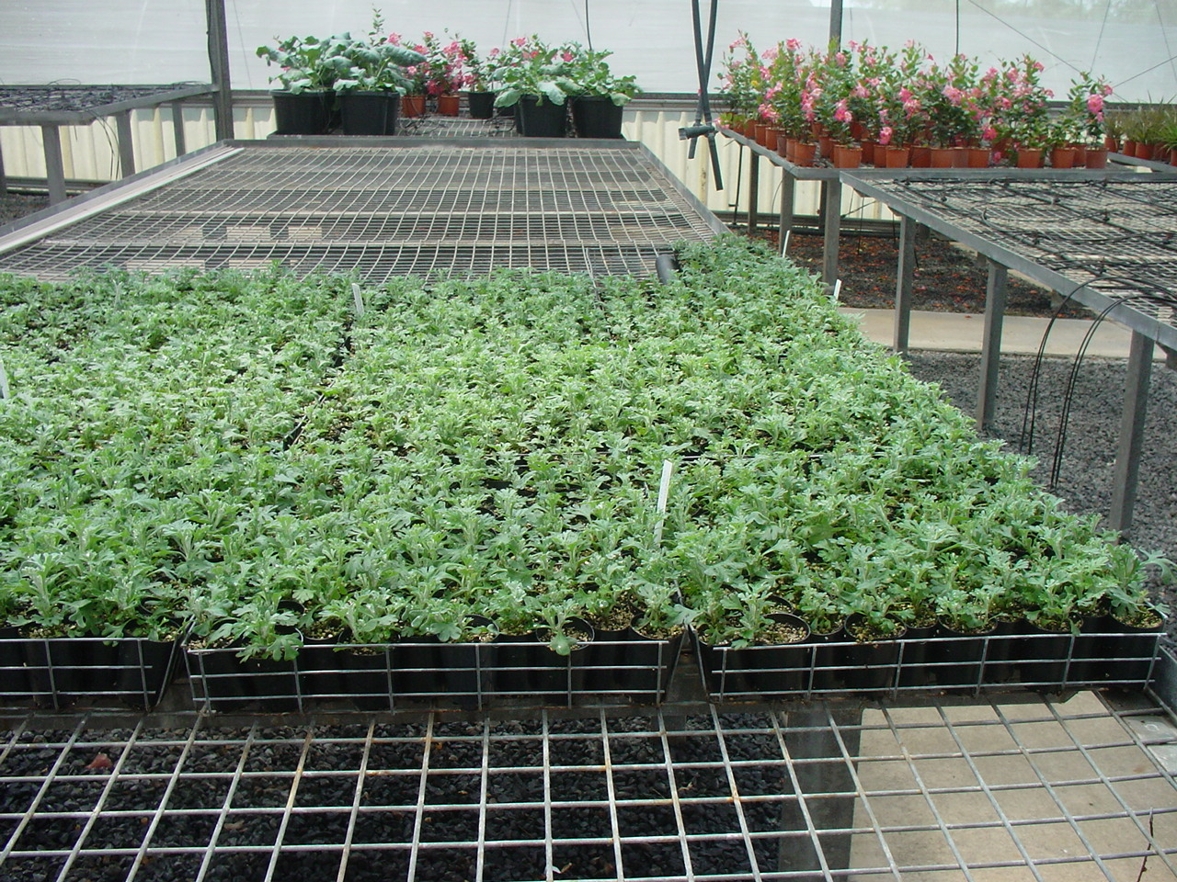

Slide 17
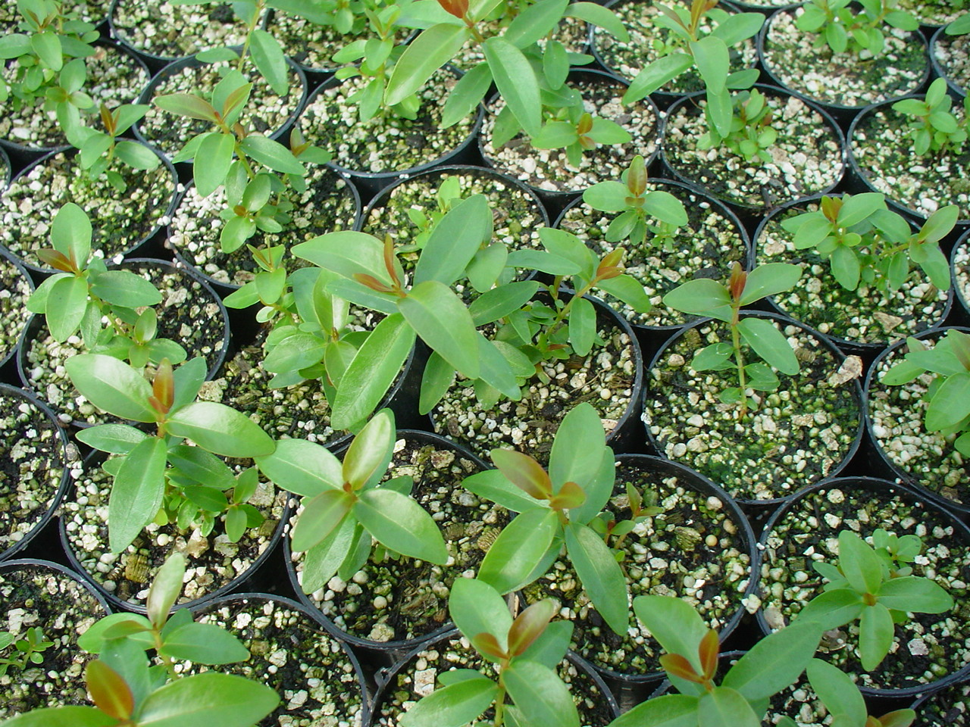

Slide 18
Applications of Biotechnology in Agriculture
Genetically Engineered Crops: Genetically engineered crops have desirable genes (as of insect/pest resistance, giving better yield) incorporated in them.
Genetically modified crops have
more tolerance to abiotic stresses such as cold, drought, salinity, heat, etc.
insect/pest resistance
reduced post-harvest losses
efficient mineral usage by plants
enhanced nutritional value (e.g., Vitamin A rich rice)

Slide 19
Bt Cotton
Bacillus thuringiensis is a bacterium that produces proteins to kill certain insects such as lepidopterans (armyworm), coleopterans (beetles), and dipterans (flies/ mosquitoes).
B. thuringiensis produces a protein crystal containing a toxic protein (inactivated state).
Inactivated toxin ^{alkaline pH} Activated toxin (gut of insect)
Activated toxin binds to the epithelial cells in the midgut of insect and creates pores that cause lyses and swelling and eventually death of insect.

Slide 20
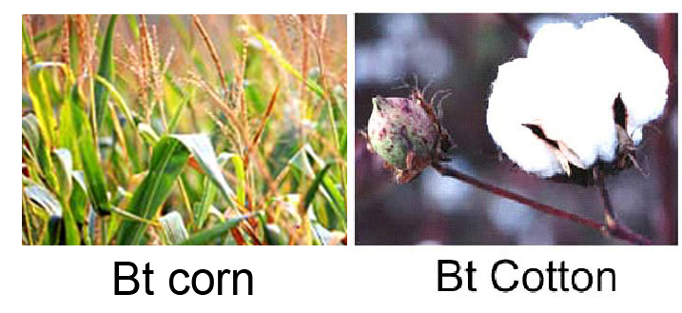
A soil bacterium is used to make plants resistant to pests:
Bacterium: Bacillus thuringiensis (Bt)
Bt produces a powerful protein toxin

Slide 21
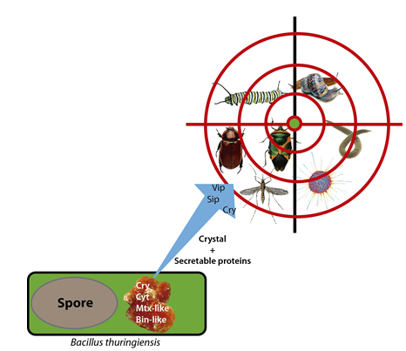
The toxin:
can be used against several species of insect pest
is 80 000 times more powerful than the insecticides commonly sprayed on crops
is fairly selective, killing only the larvae of certain species
Bacillus thuringiensis
different strains of Bt kill different insects

Slide 22
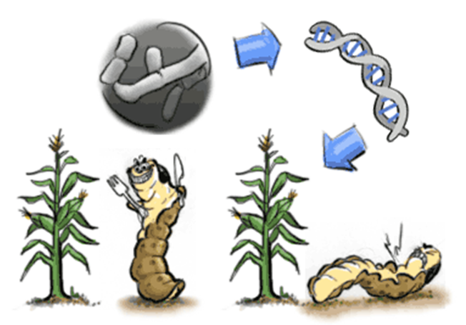
GM plant is resistant to pests
Bacillus thuringiensis
Bt gene is inserted into crop
Crop is infected
Pest dies when feeding on any plant part

Slide 23
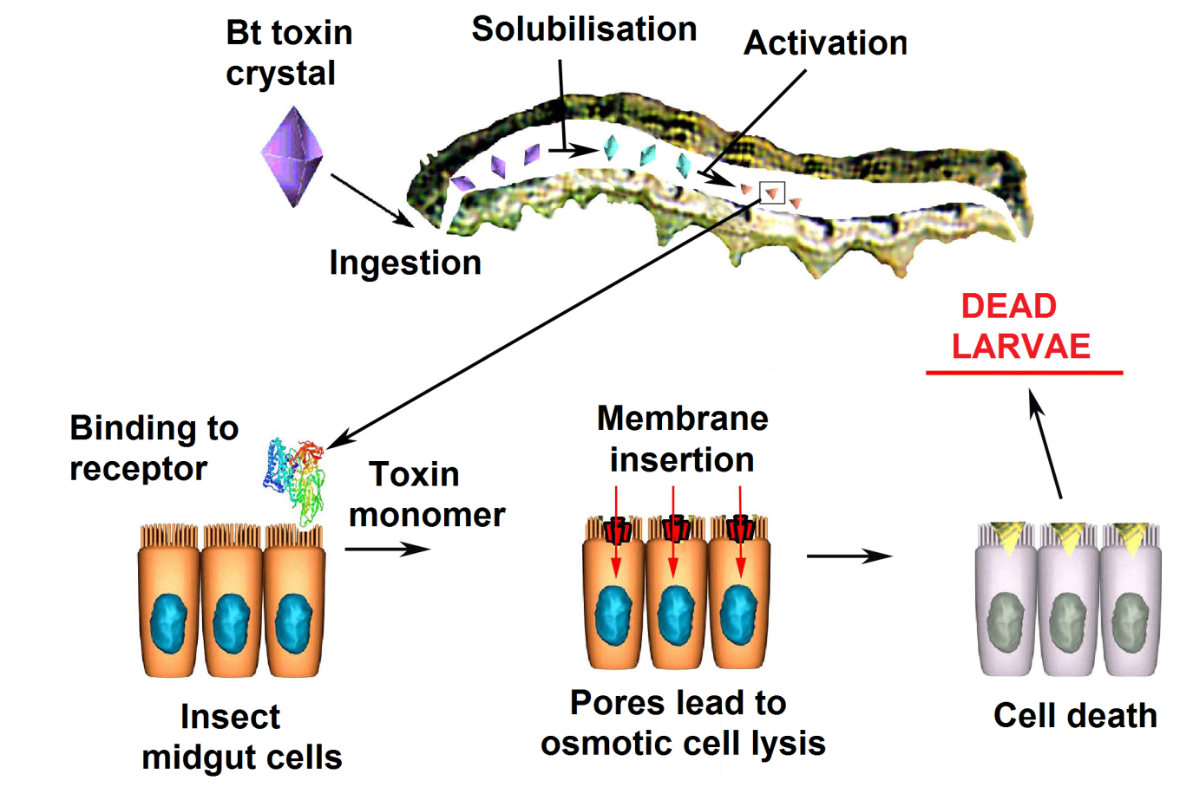
The toxin kills the pest by binding to the epithelium of the insect’s gut
damaged epithelium cannot absorb digested food and larva starves to death
Larva dies 24-48 hours after. Those killed turn black and/or shrivel.

Slide 24
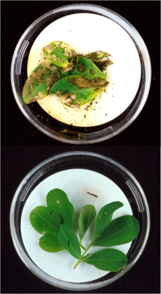
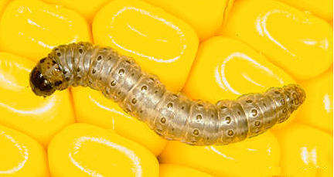
Bt toxins present in peanut leaves protect it from extensive damage caused by European corn borer larvae

Slide 25
GM cotton Plant having a gene for herbicide resistance
Both had been sprayed with a weedkiller

Slide 26
This toxin is encoded by a gene called Cry in the bacterium.
Genes encoded by Cry IAc and Cry II Ab control cotton bollworms and those encoded by Cry IAb control corn borer.
Cry genes are introduced into the cotton plants to produce Bt cotton, which is an insect resistant variety of cotton

Slide 27
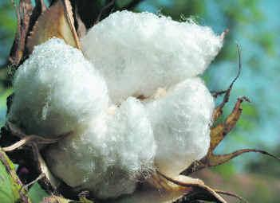
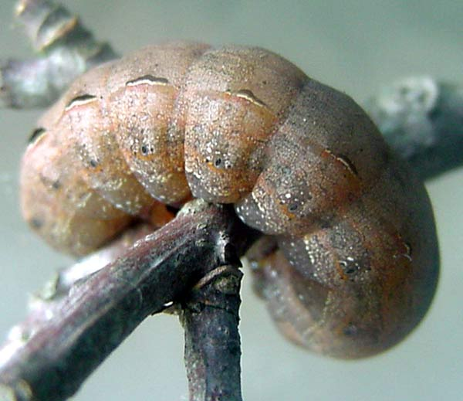

Slide 28
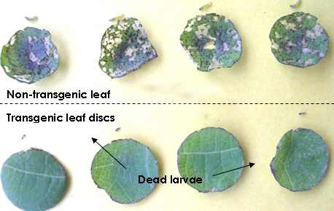

Slide 29
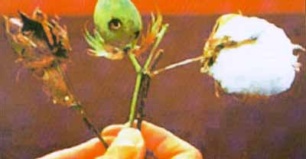
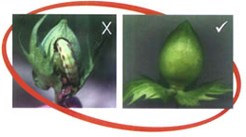

Slide 30
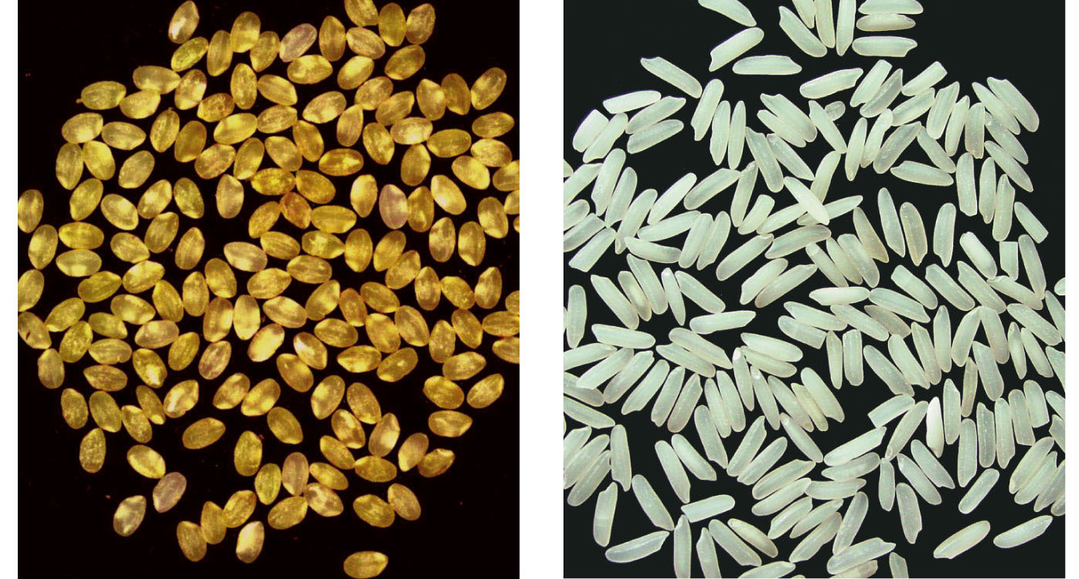
GOLDEN RICE
Increase nutritional value of food
existing food can be modified to give new characteristics
e.g. the use of a gene that increases the amount of vitamin A in rice
GM rice
Normal rice
Golden rice

Slide 32
RNA Interference (RNAi)
RNAi is a method adopted to prevent infestation of roots of tobacco plants by a nematode Meloidegyne incognitia.
RNAi exists naturally in eukaryotes as a method of cellular defence.
In RNAi, a complementary dsRNA binds to mRNA and prevent translation of the mRNA and hence, its expression is blocked (Silencing).
This complementary RNA may come from
infection by RNA viruses
transposons (mobile genetic elements)

Slide 33
Using Agrobacterium vectors, nematode specific genes (DNA) were introduced in the host plant.
The introduced DNA produced both sense and anti-sense RNA in the host cells.
Two strands being complementary to each other formed a double stranded RNA (dsRNA), leading to RNAi.
Specific mRNA of nematode is silenced and the parasite cannot survive in the transgenic host.
The transgenic plant got itself protected from the parasite.

Slide 34
Mechanism of RNA interference (RNAi)
During RNAi, the cellular enzyme Dicer binds to the dsRNA and cleaves it into short pieces of ~ 20 nucleotide pairs in length known as small interfering RNA (siRNA).
These RNA pairs bind to the cellular enzyme called RNA-induced silencing complex (RISC) that uses one strand of the siRNA to bind to single stranded RNA molecules (i.e. mRNA) of complementary sequence.
The nuclease activity of RISC then degrades the mRNA, thus silencing expression of the mRNA.

Slide 35
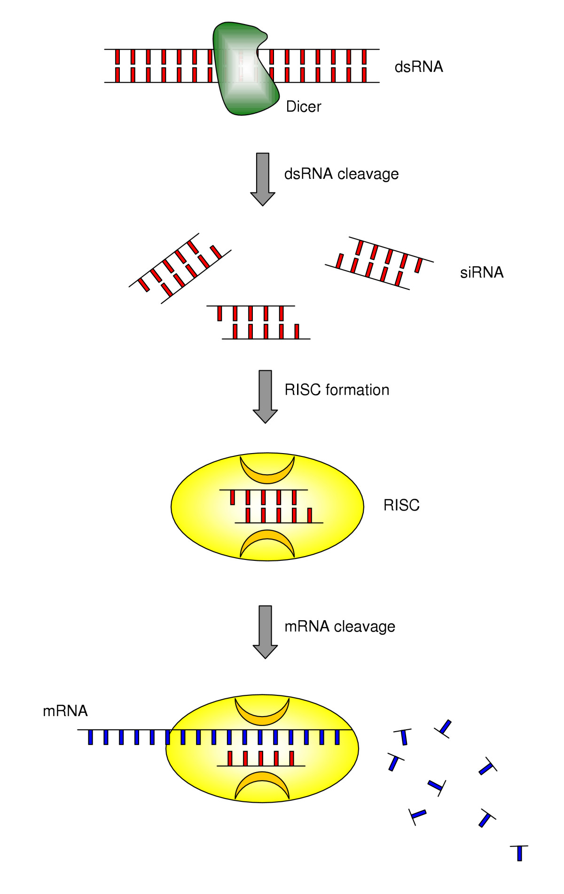

Slide 36
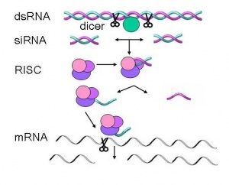
SiRNA (Small interfering RNA)
siRNA are a class of 20-25 nucleotide-long double-stranded RNA molecules that play a variety of roles in biology.
In the RNA interference
(RNAi) ,the siRNA interferes with the expression of a specific gene.

Slide 37
Dicer
Dicer is an RNAse III nuclease that cleaves double-stranded RNA (dsRNA) into siRNA.
Dicer catalyzes the first step in the RNA interference pathway and initiates formation of the RNA-induced silencing complex (RISC),
RISC is capable of degrading messenger RNA (mRNA) whose sequence is complementary to that of the siRNA guide strand.

Slide 38
Applications of Biotechnology in Medicine
Genetically Engineered Insulin
Insulin used for diabetes was earlier extracted from pancreas of slaughtered cattle and pigs.
This insulin caused some patients to develop allergy or other type of reactions to foreign protein.
By genetic engineering, the hormone insulin can be cloned in large quantities by inserting the human insulin gene into the genetic makeup of Escherichia coli bacteria.

Slide 39
Genetically Engineered Insulin
Insulin consists of two short polypeptide chains: Chain A and Chain B, linked by disulphide bridges.
In humans, insulin is synthesized as a prohormone which contain an extra chain C.
This C peptide chain is removed during maturation.
In 1983, Eli Lily, an American company prepared two DNA sequences of Chain A & B and introduced them in plasmid of E.coli to produce insulin chains.
Chains A and B were produced, extracted and combined by created disulphide bonds to form human insulin known as HUMALIN.

Slide 40
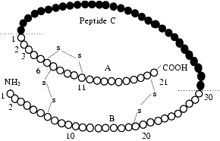

Slide 41
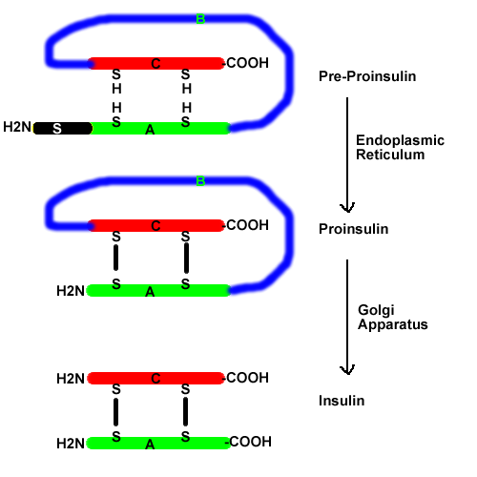

Slide 42
Gene Therapy
It means to replace a faulty gene by a normal healthy functional gene.
Example: ADA - Adenosine Deaminase Deficiency Gene Therapy - In1990, the first trial of actual gene therapy was conducted in USA.
A little (4 years old)' girl suffering with adenosine deaminase deficiency (ADA), a lethal disorder, was given genetically modified lymphocytes bearing the ADA gene .
This disease is caused due to deletion of the gene for the enzyme adenosine deaminase (ADA).
This enzyme is necessary for the immune system to function properly.

Slide 43
Gene Therapy
ADA deficiency can be cured by:
Bone Marrow Transplantation
Enzyme Replacement Therapy
But they are not completely curative.
In gene therapy, lymphocytes are extracted from the blood of the patient.
A good copy of the human gene encoding ADA enzyme is introduced into these cells using a retroviral vector.
The cells thus treated are then re-injected to the patients.
Lymphocytes now produced have a fully functional ADA gene and they produce ADA to help the patients immune system.

Slide 44
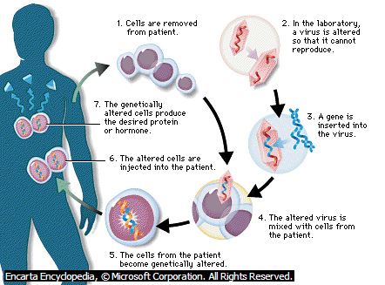

Slide 45
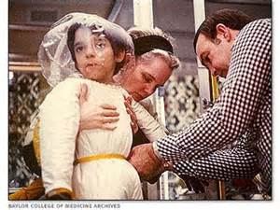
Severe combined immunodeficiency (SCID)
Is a rare disorder in which a child fails to develop an immune system
Ten known forms of SCID:
One form is due to a mutation in a gene located on the X chromosome - affects mostly boys
Unless the genetic defect is corrected the child will die of opportunistic infections before its first or second birthday

Slide 46
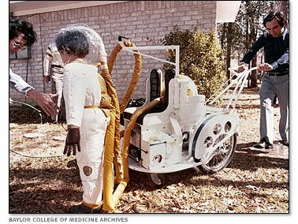
Incidence of X-linked SCID:
1 in 50, 000 to 1 in 100, 000
Diagnosis of X-SCID:
individuals with X-SCID will contain:
unusually small amounts of T-cells
non-functional B-cells
no natural killer cells

Slide 47
Treatment:
1. bone marrow or stem cell transplantation:
the conventional treatment has:
Excellent results with a full matched donor
less satisfactory results with a poorer match:
1/3 of X-SCID patients will have a fully matched donor
transplantation involves powerful chemotherapy
up to 20% of children transplanted with a less than full match die

Slide 48
Gene therapy has therefore been a highly valuable treatment option for this group of children.
2. gene therapy
a very small number of cases have been treated using gene therapy
is experimental
only available in clinical trials
gene therapy for X-SCID has been controversial since 2005, when 5/11 children in Europe got leukemia from the retrovirus used in experimental treatments

Slide 49
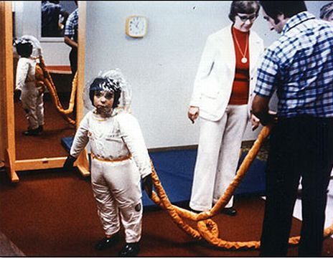
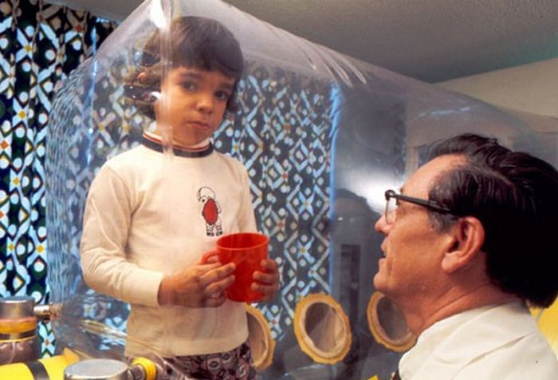
Bubble Baby Syndrome
David Vetter (1971 –1984) suffered from SCID.
He was forced to live in a sterile environment.
He died of cancer in 1984 after an unmatched bone marrow transplant from his sister.
1976 film based upon David’s life

Slide 50
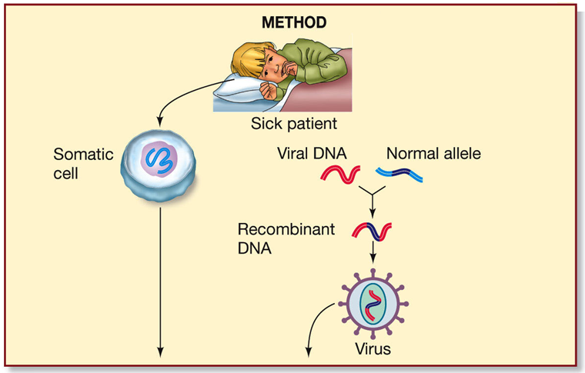
Gene Therapy: Ex vivo approach
1. Blood stem cells are isolated from the bone marrow.
2. A copy of the normal allele is inserted into viral DNA.

Slide 51
3. Isolated somatic cells are infected with the virus containing the normal allele.
4. The viral DNA carrying the normal allele is inserted into the patient’s somatic cell chromosome.
5. Somatic cells containing the normal allele are cultured.
6. Cultured cells are injected into the patient.
7. Symptoms are relieved by expression of the normal allele.

Slide 52
Molecular diagnosis
Using conventional methods of diagnosis (Serum and Urine analysis etc.) early detection is not possible.
Now-a-days, many techniques are used to diagnose the presence of pathogen at very early stage such as:-
Recombinant DNA Technology,
Polymerase Chain Reaction (PCR)
Enzyme Linked Immuno - Sorbent Assay (ELISA)

Slide 53
Recombinant DNA Technology
A single stranded DNA or RNA, tagged with a radioactive molecule(probe) is allowed ot hybridise to its complementary DNA in a clone of cells followed by detection using autoradiography.
The clone having the mutated gene will hence not appear on the photographic film, because the probe will not have complimentary with the mutated gene.

Slide 54
Polymerase Chain Reaction (PCR)
Very low concentration of a bacteria or virus can be detected by amplification of their nuceic acid by PCR.
PCR can be used :
To detect HIV in suspected AIDS patients
To detect mutation in genes in cancer patients.
Other genetic disorders

Slide 55
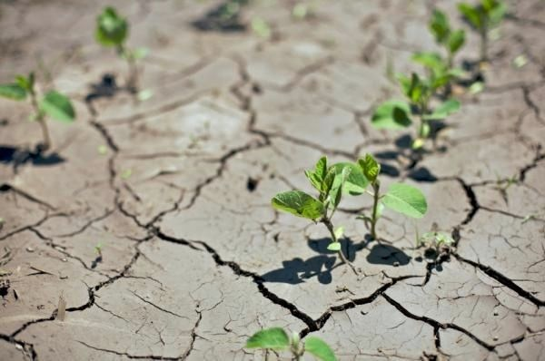
Advantages of genetic engineering
Environmental tolerance
plants can be genetically modified to tolerate colder or warmer, drier or wetter conditions
i.e. plants can be grown in a wider range of countries than presently

Slide 56
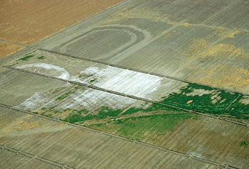
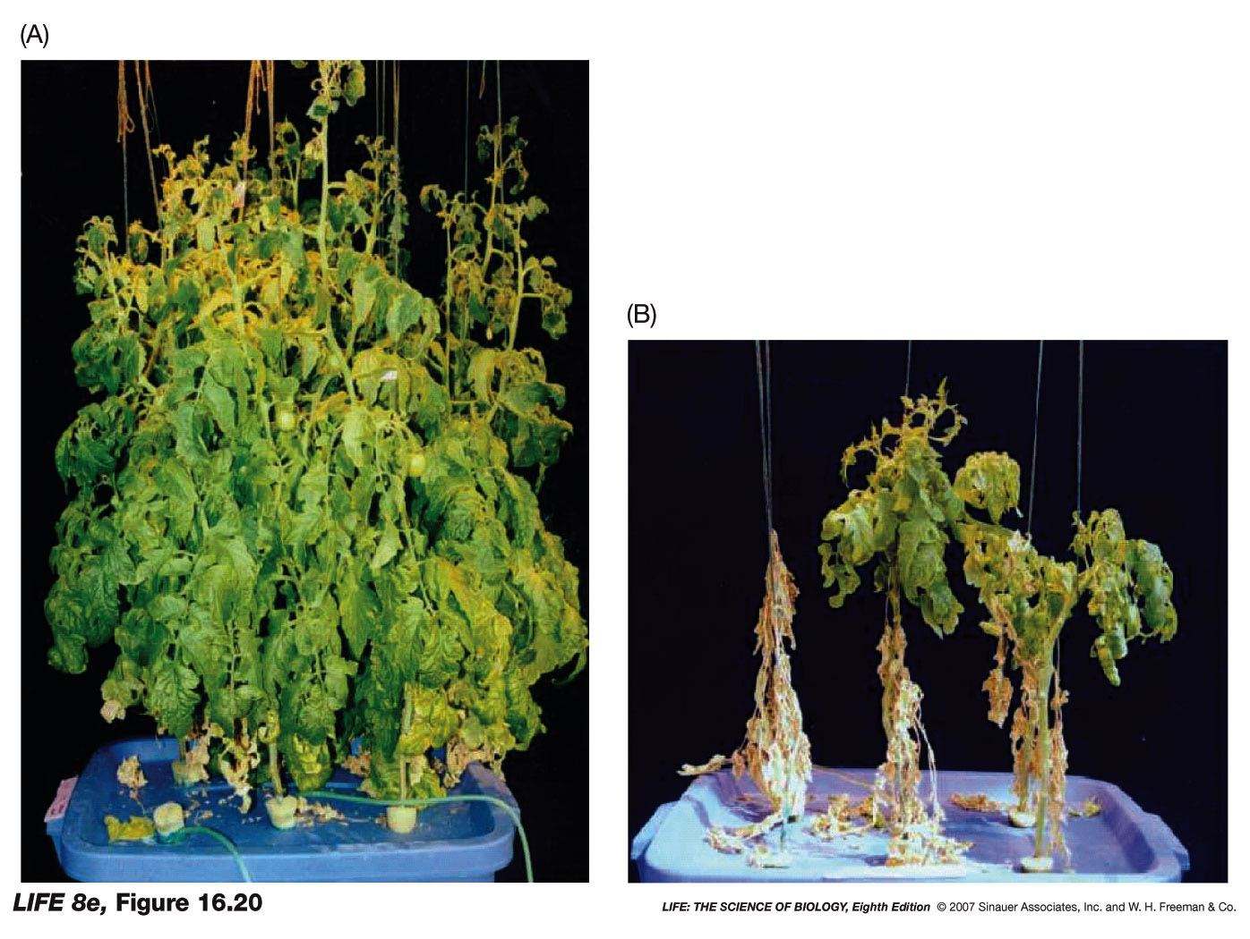
What is the benefit of producing salt tolerant plants?
Salt tolerant
Natural plant

Slide 57
GM cotton Plant having a gene for herbicide resistance
Both had been sprayed with a weedkiller

Slide 58
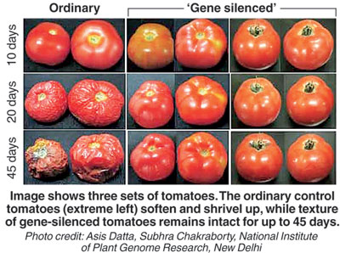
Advantages of genetic engineering
Longer shelf life
currently many foods have a limited shelf life
this means that they cannot be transported easily to distant markets
GE has the potential to increase the shelf life of foods

Slide 59
Advantages of genetic engineering
Better colour or taste
GE has the potential to increase the range of colours found currently in flowers or enhance the taste of foods
e.g. blue roses

Slide 60
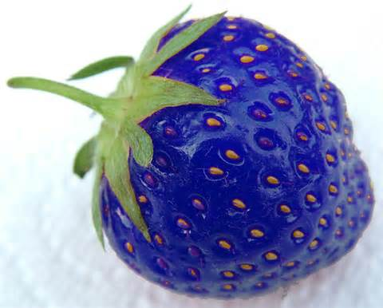
Scientists have come up with a blue strawberry by splicing them with fish genes
Scientists are genetically modifying strawberries in order to allow them to resist freezing temperatures better
The blue colour was purely unintentional
A gene in "Artic Flounder Fish" that produces an antifreeze was inserted
The blue fruit can withstand very cold temperatures

Slide 61
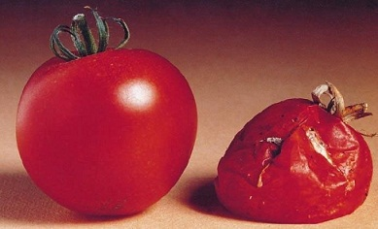
Advantages of genetic engineering
Better handling characteristics
Foods transferred from producer to market are often damaged
GE has the potential to produce foods that resist bruising when transported or resist “going brown” after being cut
e.g. GM tomatoes
Flavr savr tomato

Slide 62
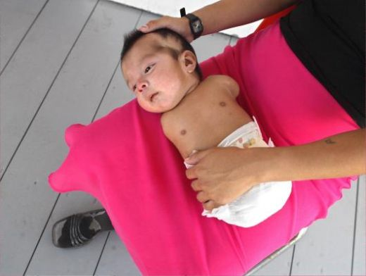
Baby suffers due to mother being exposed to pesticides. Pesticides led to loss of limbs in infant .

Slide 63
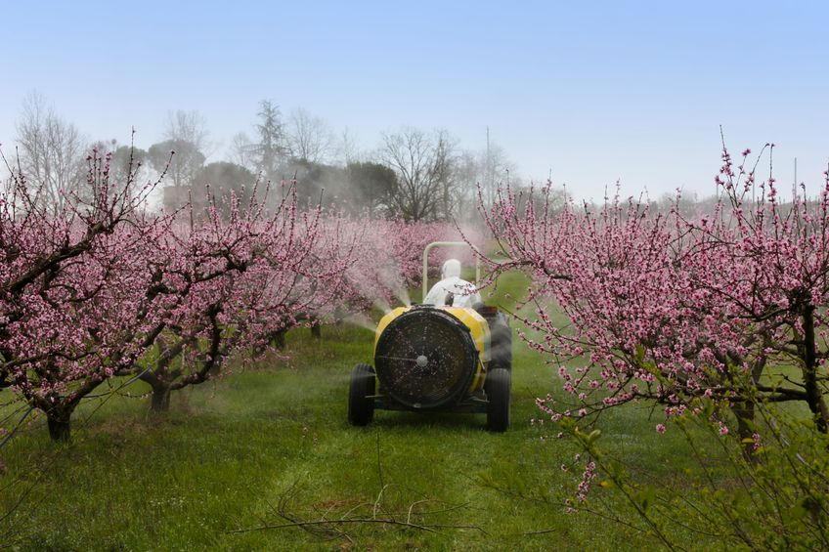
Advantages of genetic engineering
Fewer chemical residues in food chain
as less pesticides are applied in fields with GE plants & animals that are pest or disease resistant
so the chemical residues in the food chain are reduced

Slide 64
Read through the following passage on gene technology (genetic engineering), then write on the lines the most appropriate word or words to complete the passage.
The isolation of specific genes during a genetic engineering process involves forming eukaryotic DNA fragments. These fragments are formed using ___________ enzymes which make staggered cuts in the DNA within specific base sequences. This leaves single-stranded ‘sticky ends’ at each end. The same enzyme is used to open up a circular loop of bacterial DNA which acts as a _____________ for the eukaryotic DNA.
restriction
vector

Slide 65
The complementary sticky ends of the bacterial DNA are joined to the DNA fragment using another enzyme called ___________. DNA fragments can also be made from _______ template. Reverse transcriptase is used to produce a single strand of DNA and the enzyme _____________ catalyses the formation of a double helix. Finally new DNA is introduced into host ________ cells. These can then be cloned on an industrial scale and large amounts of protein harvested. An example of a protein currently manufactured using this technique is _________________________.
DNA ligase
mRNA
DNA polymerase
Bacterial
insulin / human growth hormone

Slide 66
TRANSGENIC ANIMALS
Animals that have had their DNA manipulated to possess and express an extra (foreign) gene are known as transgenic animals. Transgenic rats, rabbits, pigs, sheep, cows and fish have been produced, although over 95 per cent of all existing transgenic animals are mice.

Slide 67
Let us try and explore some of the common reasons of transgenic animals:
(i) Normal physiology and development: Transgenic animals can be specifically designed to allow the study of how genes are regulated, and how they affect the normal functions of the body and its development, e.g., study of complex factors involved in growth such as insulin-like growth factor. By introducing genes from other species that alter the formation of this factor and studying the biological effects that result, information is obtained about the biological role of the factor in the body.
(ii) Study of disease: Many transgenic animals are designed to increase our understanding of how genes contribute to the development of disease. These are specially made to serve as models for human diseases so that investigation of new treatments for diseases is made possible. Today transgenic models exist for many human diseases such as cancer, cystic fibrosis, rheumatoid arthritis and Alzheimer’s

Slide 68
(iii) Biological products: Medicines required to treat certain human diseases can contain biological products, but such products are often expensive to make.
Transgenic animals that produce useful biological products can be created by the introduction of the portion of DNA (or genes) which codes for a particular product such as human protein (α-1-antitrypsin) used to treat emphysema.
Similar attempts are being made for treatment of phenylketonuria (PKU) and cystic fibrosis.
In 1997, the first transgenic cow, Rosie, produced human protein-enriched milk (2.4 grams per litre). The milk contained the human alpha-lactalbumin and was nutritionally a more balanced product for human babies than natural cow-milk.

Slide 69
(iv) Vaccine safety: Transgenic mice are being developed for use in testing the safety of vaccines before they are used on humans.
Transgenic mice are being used to test the safety of the polio vaccine. If successful and found to be reliable, they could replace the use of monkeys to test the safety of batches of the vaccine.
(v) Chemical safety testing: This is known as toxicity/safety testing. The procedure is the same as that used for testing toxicity of drugs. Transgenic animals are made that carry genes which make them more sensitive to toxic substances than non-transgenic animals.
They are then exposed to the toxic substances and the effects studied. Toxicity testing in such animals will allow us to obtain results in less time.

Slide 70
ETHICAL ISSUES
Going beyond the morality of such issues, the biological significance of things is also important. Genetic modification of organisms can have unpredicatable results when such organisms are introduced into the ecosystem.
Therefore, the Indian Government has set up organisations such as GEAC (Genetic Engineering Approval Committee), which will make decisions regarding the validity of GM research and the safety of introducing GM-organisms for public services.
Biopiracy is the term used to refer to the use of bio-resources by multinational companies and other organisations without proper authorisation from the countries and people concerned without compensatory payment.

Slide 71
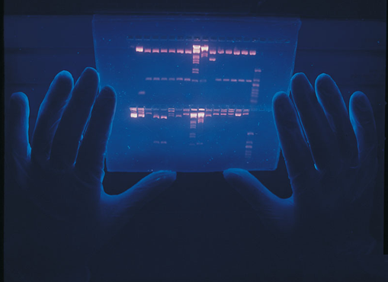
THE END

